Slide 1
Clusters
Portions of this PPT draw from PPT authored by ShopniL Mahmud

Slide 2
TABLE OF CONTENTS
Table of Contents
- Introducing Cluster Concept
- About Cluster Computing
- Concept of whole computers and it’s benefits
- Architecture and Clustering Methods
Different clusters catagorizations
Issues to be consitered about clusters
- Implementations of clusters
Clusters technology in present and future
Conclusions

Slide 3

Introducing Clusters Computing
A computer cluster is a group of tightly coupled
computers that work together closely so that it can be viewed as a single computer.
Clusters are commonly connected through fast
local area networks.
Clusters have evolved to support applications ranging from e-commerce, to high performance database applications.

Slide 4
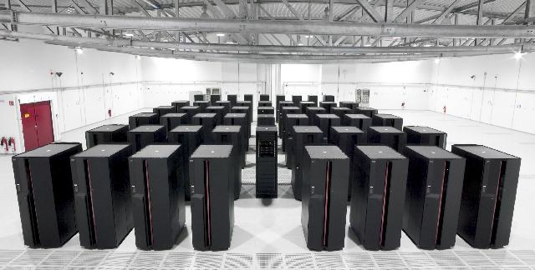
Cluster Computers in view

Slide 5
Cluster Computing
A group of interconnected WHOLE COMPUTERS works together as a unified computing resource that can create the illusion of being one machine having parallel processing.
The components of a cluster are commonly, but not always, connected to each other through fast local area networks.

Slide 6

What’s Whole Computer
A system that can refer run on its own apart from the cluster; used in server systems are called whole computers.

Slide 7
Why is Clusters than single 1’s?
Price/Performance
The reason for the growth in use of clusters is that they have significantly reduced the cost of processing power.
Availability
Single points of failure can be eliminated, if any one system component goes down, the system as a whole stay highly available.
Scalability
HPC clusters can grow in overall capacity because processors and nodes can be added as demand increases.
Notes:
Clusters are deployed to improve performance and/or availability over that of a single computer, while typically being much more cost-effective than single computers of comparable speed or availability.

Slide 8
Where does it matter?
The components critical to the development of low cost clusters are:
Processors
Memory
Networking components
Motherboards, busses, and other sub-systems

Slide 9
Short History …
The first commodity clustering product was ARCnet, developed by Datapoint in 1977.
The next product was VAXcluster, released by DEC in 1980’s.
Microsoft, Sun Microsystems, and other leading hardware and software companies offer clustering packages.
But Linux is the most widely used operating systems ever since for cluster computers around the world.

Slide 10
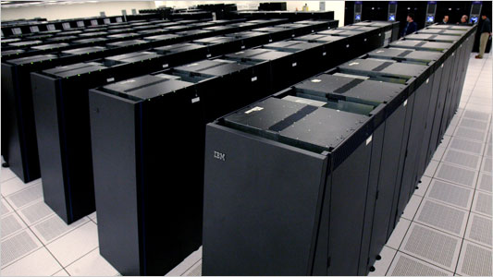
IBM hidro Clusters

Slide 11
Clusters Architecture
A cluster is a type of parallel /distributed processing system,which consists of a collection of interconnected stand-alone computers cooperatively working together a single, integrated computing resource.
A node:
a single or multiprocessor system with memory, I/O facilities, &OS
generally 2 or more computers (nodes) connected together
in a single cabinet, or physically separated & connected via a LAN
appear as a single system to users and applications
provide a cost-effective way to gain features and benefits

Slide 12
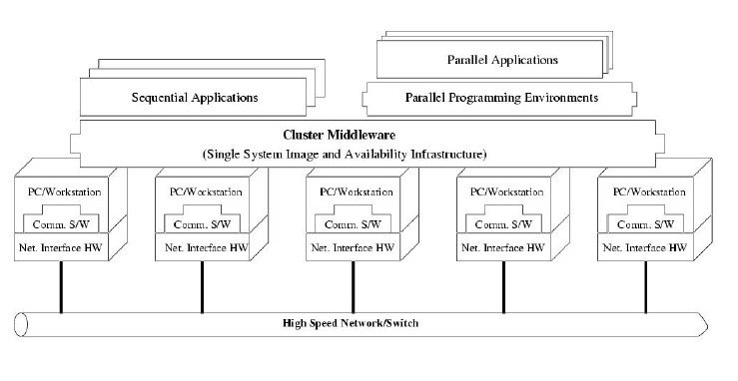
Architecture of Clusters

Slide 13
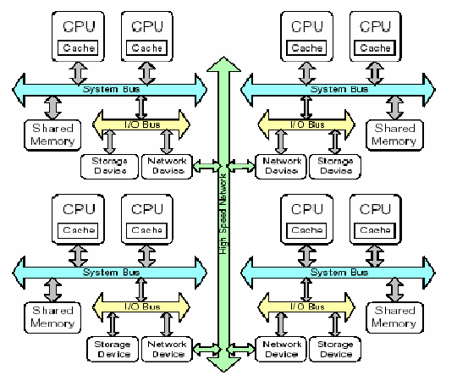
How Clusters works?

Slide 14
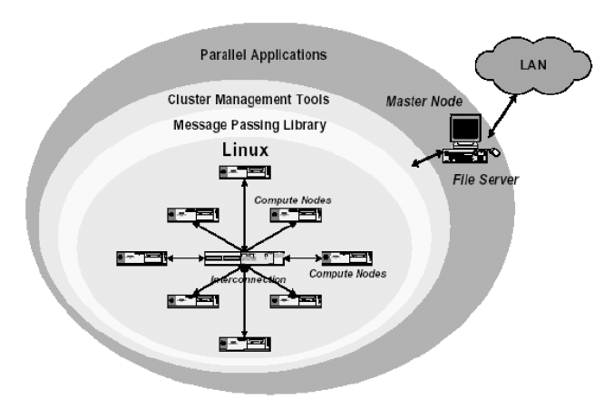
A logical view for clusters

Slide 15
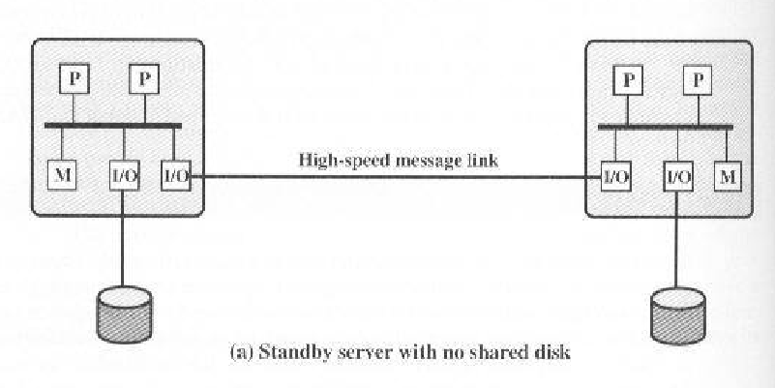
Configuration Of Figure A
Two node cluster
Connected by means of a high speed link
Link can be a LAN shared with other non cluster computers or it can
be a dedicated interconnection facility
Each node is a multiprocessor
Being multiprocessor is not necessary but it enhances performance and availability

Slide 16
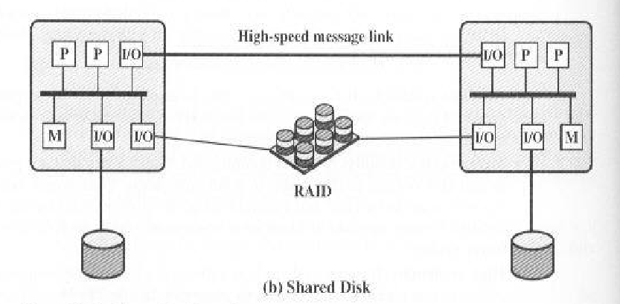
Configuration of figure B
Shared disk cluster
Message link between nodes
Also, there is a disk subsystem directly linked to multiple computers within the cluster
Common disk subsystem is a RAID
RAID is used so that high availability is not compromised by a shared disk that is a single point of failure

Slide 17
Clustering Methods
CLUSTERING METHOD | DESCRIPTION | BENEFITS | LIMITATIONS
Passive standby | A secondary server takes over in case of primary server failure | Easy to implement | High cost because the secondary server is unavailable for other processing tasks
Active standby | The secondary server is also used for processing tasks | Reduced cost because secondary servers can be used for processing | Increased complexity
Separate servers | Separate servers have their own disks. Data are continuously copied from primary to secondary server | High availability | High network and server overhead due to copying operations
Servers connected to disks | Servers are cabled to the same disks, but each server owns its disk. If one server fails, its disks are taken over by the other server | Reduced network and server overhead due to elimination of copying operations | Usually requires disk mirroring or RAID technology to compensate for risk of disk failure
Servers share disks | Multiple servers simultaneously share access to the disks | Low network and server overhead. Reduced risk of downtime caused by disk failure | Requires lock manager software. Usually used with disk mirroring or RAID technology

Slide 18
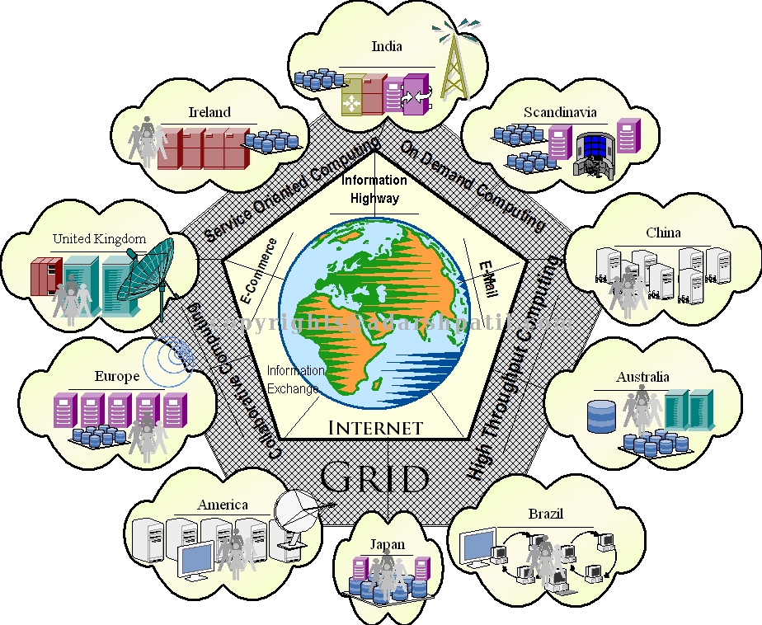
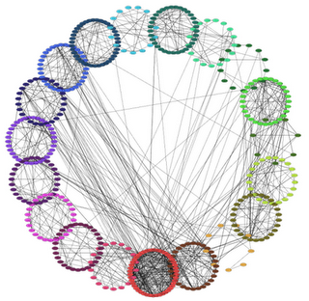
Cluster Catagorization
High-availability (HA)
Load-balancing
High- Performance(HP)

Slide 19
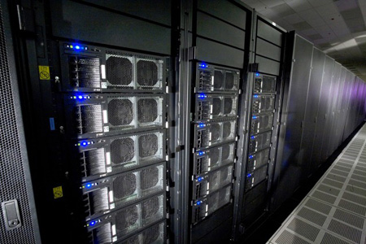
High Availability Clusters
Avoid single point of failure
This requires atleast two nodes - a primary and a backup.
Always with redundancy
Almost all load balancing cluster are with HA capability.
Notes:
High-availability clusters (also known as Failover Clusters) are implemented primarily for the purpose of improving the availability of services that the cluster provides.
They operate by having redundant nodes, which are then used to provide service when system components fail.
The most common size for an HA cluster is two nodes, which is the minimum requirement to provide redundancy.
HA cluster implementations attempt to use redundancy of cluster components to eliminate single points of failure.
There are commercial implementations of High-Availability clusters for many operating systems. The Linux-HA project is one commonly used free software HA package for the Linux operating system.

Slide 20
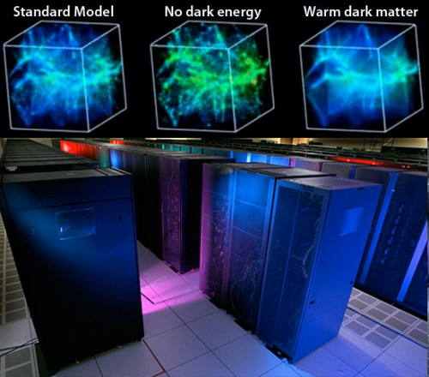
Load Balancing Clusters
PC cluster deliver load balancing performance
Commonly used with busy ftp and web servers with large client base
Large number of nodes to share load
Notes:
Load-balancing is when multiple computers are linked together to share computational workload or function as a single virtual computer.
Logically, from the user side, they are multiple machines, but function as a single virtual machine.
Requests initiated from the user are managed by, and distributed among, all the standalone computers to form a cluster.
This results in balanced computational work among different machines, improving the performance of the cluster system.

Slide 21
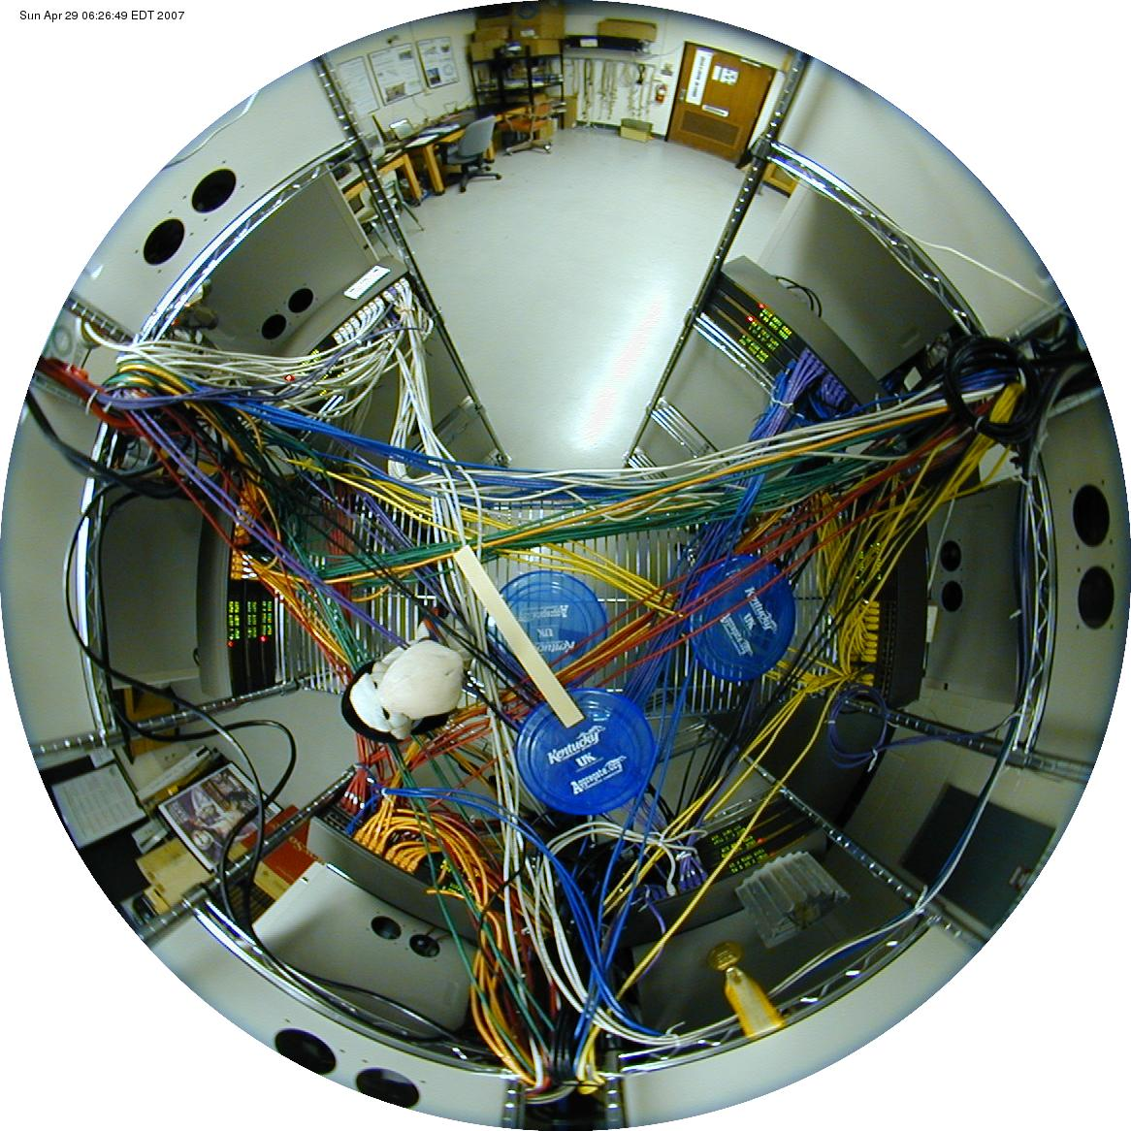
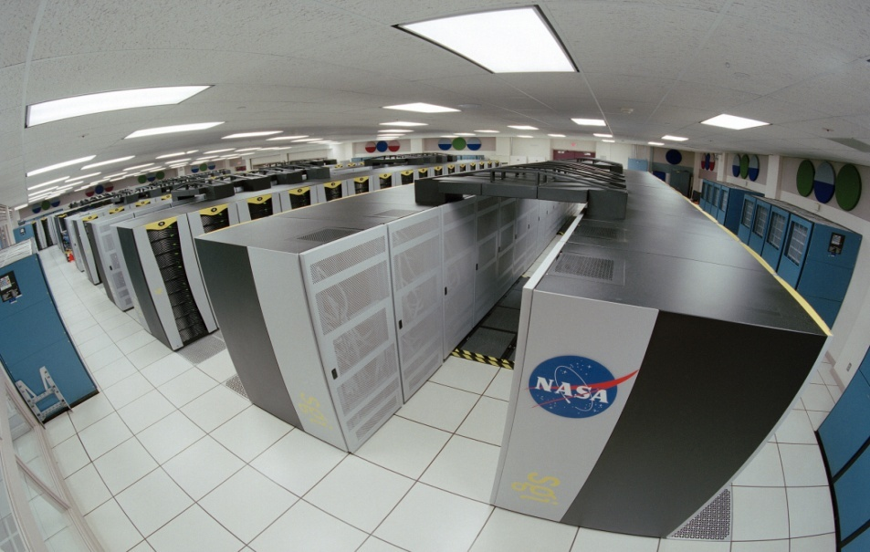
High Performance Clusters
Start from 1994
Donald Becker of NASA assembled this cluster.
Also called Beowulf cluster
Applications like data mining, simulations, parallel
processing, weather modeling, etc.

Slide 22
Issues to be considered about
Cluster Networking
Cluster Software
Programming
Timing
Network Selection
Speed Selection

Slide 23


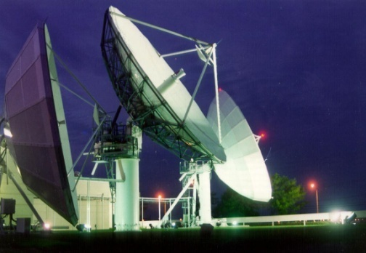
Cluster Networking
Huge difference in the speed of data accessibility and transferability and how the nodes communicate.
Just got to make sure that if it’s in your budget then the clusters have the similar networking capabilities and if possible, then buy the network adapters from the same manufacturer.

Slide 24
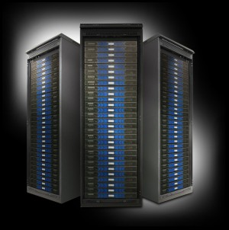

Cluster Software
You will have to build versions of clustering software for each kind of system you include in your cluster.

Slide 25
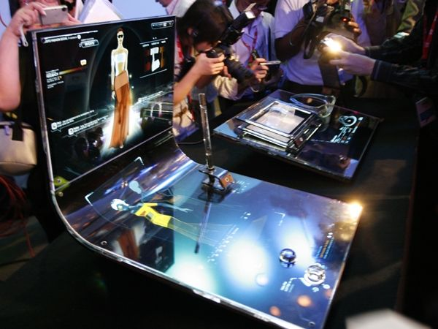

Programming
Our code will have to be written to support the lowest common denominator for data types supported by the least powerful node in our cluster. With mixed machines, the more powerful machines will have attributes that cannot be attained in the powerful machine.

Slide 26
TiminG
Timing
This is the most problematic aspect of cluster. Since these machines have different performance profile our code will execute at different rates on the different kinds of nodes. This can cause serious bottlenecks if a process on one node is waiting for results of a calculation on a slower node..

Slide 27
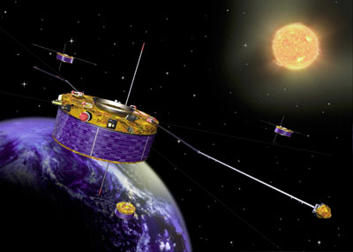

Network Selection
Network Selection
There are a number of different kinds of network topologies, including buses, cubes of various degrees, and grids/meshes. These network topologies will be implemented by use of one or more network interface cards, or NICs, installed into the head-node and compute nodes of our cluster.

Slide 28
Right Speed Selection
Speed Selection
  No matter what topology you choose for your cluster, you will want to get fastest network that your budget allows. Fortunately, the availability of high speed computers has also forced the development of high speed networking systems.
Examples are :
10Mbit Ethernet, 100Mbit Ethernet, gigabit networking, channel bonding etc.

Slide 29
Implementation of Clusters
The TOP 500 organization's semi-annual list of the 500 fastest computers usually includes many clusters.
As of June 18, 2008, the top supercomputer is the Department of Energy's IBM Roadrunner system with performance of 1026 TFlops measured with High-Performance LINPACK benchmark.
Clustering can provide significant performance benefits versus price. The System X supercomputer at Virginia Tech.

Slide 30
Implementation of Clusters
the 28th most powerful supercomputer on Earth as of June 2006, is a 12.25 TFlops computer cluster of 1100 Apple XServe G5 2.3 GHz dual-processor machines (4 GB RAM, 80 GB SATA HD) running Mac OS X and using InfiniBand interconnect.
The total cost of the previous Power Mac system was $5.2 million, a tenth of the cost of slower mainframe computer supercomputers. (The Power Mac G5s were sold off.)
The central concept of a Beowulf cluster is the use of commercial off-the-shelf (COTS) computers to produce a cost-effective alternative to a traditional supercomputer. One project that took this to an extreme was the Stone Soupercomputer.
Notes:
The cluster initially consisted of Power Mac G5s; the rack-mountable XServes are denser than desktop Macs, reducing the aggregate size of the cluster.

Slide 31
Implementation of Clusters
clusters are excellent for parallel computation, but much poorer than traditional supercomputers at non-parallel computation.
JavaSpaces is a specification from Sun Microsystems that enables clustering computers via a distributed shared memory.
gridMathematica - computer algebra and 3D visualization.
High powered Gaming.

Slide 32
Cluster Technologies
MPI is a widely-available communications library that enables parallel programs to be written in C, Fortran, Python, OCaml, and many other programming languages.
The GNU/Linux world supports various cluster software; for application clustering and etc.
Microsoft Windows Compute Cluster Server 2003 based on the Windows Server platform provides pieces for High Performance Computing. This cluster debuted at #130 on the Top500 list in June 2006.
Notes:
Message passing interface(MPI).

Slide 33

Conclusion …
Clusters are promising
Solve parallel processing paradox
New trends in hardware and software technologies are likely to make clusters.
Clusters based supercomputers (Linux based clusters) can be seen everywhere !!!

Slide 34
Thank you so much …
Is there any further query regarding clusters?

